Slide 1
EE542 - Reading Assignment 02 The performance of TCP/IP for networks with high bandwidth-delay products and random loss
Presenter: Boyang Xiao
USC id: 3326730274
Email: boyangxi@usc.edu

Slide 2
Index
Paper main ideas
System model and evolution w/o Random loss
Evolution w/ random loss
Multiple TCP connections
Conclusions and further works

Slide 3
Paper main ideas
Build a basis understanding of the properties of TCP/IP
Analyze the phases evolutions and performance of TCP/IP when or when not encountering congestions and fluctuations based on random loss models
Provide modifications to network and transport layers for better end-to-end performance over WANs

Slide 4
System model and evaluations w/o Random loss
Random Loss
A scenario of particular interest in the context of networks with multimedia traffic, where transient fluctuations in real time traffic may cause irregularly spaced losses for data traffic
System model we are going to analyze:
Infinite data sources(Always has packets to send)
Max packet sizes
Only one single bottleneck link with capacity μ packets/sec
One FIFO buffer of size B packets

Slide 5
System model and evaluations w/o Random loss
System Model Figure
Propagation and ACK delay
TAU_1
Source 1
Bottleneck link
FIFO buffer
Destination
Source 2
TAU_3
Source 3
TAU_2

Slide 6
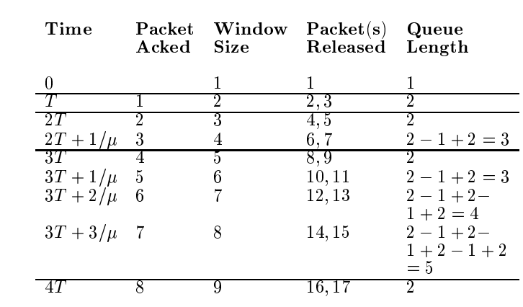
System model and evaluations w/o Random loss
Evaluations w/o random losses
We care about a single connection’s long-term throughput
Phase I: Slow start phase’s evolution

Slide 7
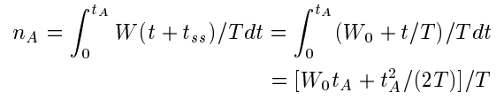


System model and evaluations w/o Random loss
Phase II: Congestion Avoidance Phase
Starts from an arbitrary window size W0
Packets sent during the phase:
Packets sent when the bottleneck link is fully utilized:
where:

Slide 8
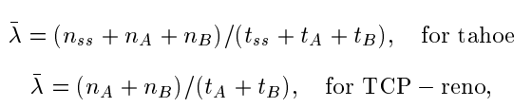
System model and evaluations w/o Random loss
Throughput for this model:

Slide 9
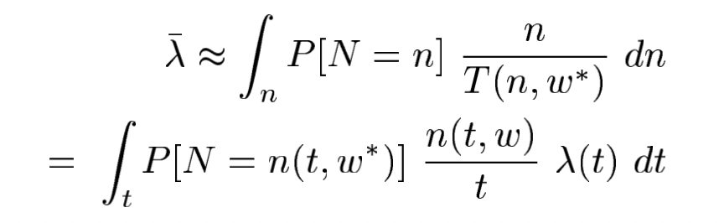
Evolution w/ random loss
Scenario:
Any packet has a probability of loss : q
Packet loss events are independent
Throughput under random losses

Slide 10
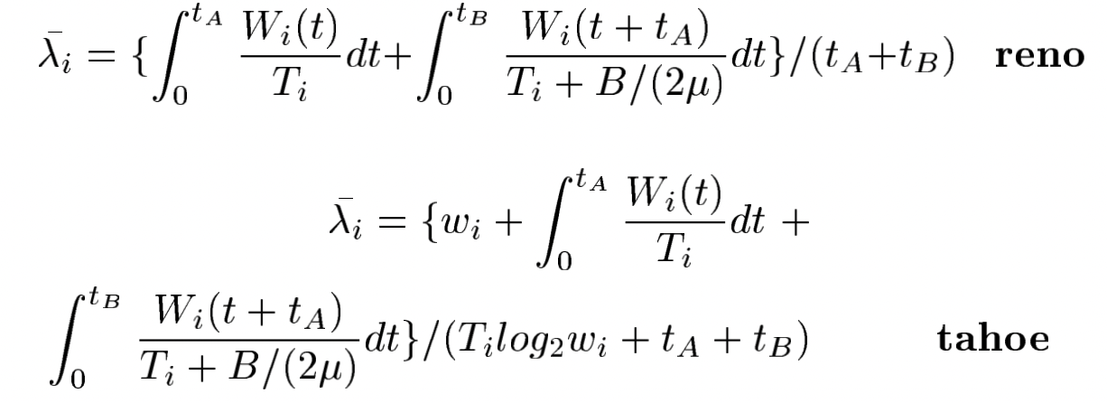
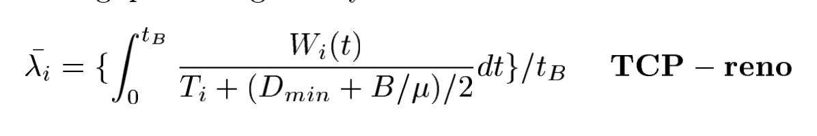
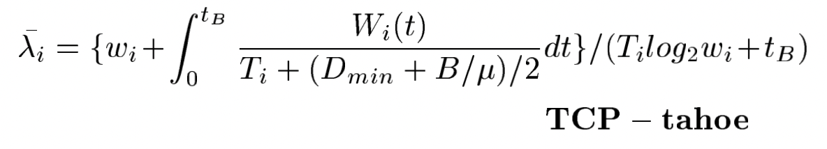
Multiple TCP connections
Scenario:
Longer RTT
Multiple TCP connections
Window adjustment mechanisms
Numerical analysis and results:
- Case 1: Small buffers - Case 2: Larger buffers

Slide 11
Conclusions and further works
TCP's TAHOE feature makes exponential increase of window size in slow start necessary
TCP’s vulnerability makes it difficult to multiplex data traffic with real-time delivering rate
TCP’s unfairness towards connections with higher delays could cause performance problems when multiplexing short and long-haul traffic on WANs
Loss is the only ways for feedback in TCP and it leads to excessive delays
Bias against connections with higher delays can be removed by modifying mechanisms for probing for bandwidth during congestions

Slide 12
Thank you for watching! The performance of TCP/IP for networks with high bandwidth-delay products and random loss
Presenter: Boyang Xiao
USC id: 3326730274
Email: boyangxi@usc.edu

